Slide 1
Knee Osteoarthritis
Early Detection of Knee Osteoarthritis and determining it’s severity degree based on deep neural network

Slide 2
Members of team: Supervised:
1- Mario Ashraf yaqoub Dr: Khaled Wassif
2- Thomas Hany Nagy Eng: Zienab Mostafa
3- Youssef Mohsen Thabeet
4- Yassa Akram Roshdy
5- Sara Bakhet Falltous
6- Merna Samir Fouad
7- Roudia Abdelrhman and Elmonem Abd Elrzak

Slide 3
Table of Content
• Introduction.
• CAN Knee-Osteoarthritis prevent you from moving ?!
• Knee-Osteoarthritis dataset.
• Ai & Machine learning.
• Proposed Model.
• GUI.

Slide 4
Introduction
Knee osteoarthritis (OA), also known as degenerative joint disease of the knee, is typically the result of wear and tear and progressive loss of articular cartilage. It is most common in the elderly.

Slide 5
What is Knee ?
The knee is the joint that connects your thigh to your lower leg. It's the biggest joint in your body. Like all joints, your knees are part of your skeletal system. Your knees also contain cartilage, muscles, ligaments and nerves. Your knees help support your weight and let your legs bend and move.

Slide 6
Can Knee Osteoarthritis prevent you from moving?
A true locked knee happens when your knee joint is literally locked into place and cannot move, where as a pseudo locked knee occurs when moving the knee becomes difficult as a result of pain.
• Common clinical symptoms include:
• Knee pain that is gradual in onset and worsens with activity.
• Knee stiffness and swelling.
• Pain after prolonged sitting or resting.
• Crepitus or a cracking sound with joint movement.

Slide 7
Free Small Talk
What about this system
What is our system can do
What user should do
Recommendations to the user
How patients communicate
Patient communicate with doctor.

Slide 8
State of problem
The problems :
• Patient faces a problem of how to detect knee osteoarthritis.
• There are difficulties to present results of X-ray knee in an easy way.
• Some of patients face a problem in find doctors and follow up with them.
• There are difficulties to find an application which help to predict the Knee Osteoarthritis and its Grades

Slide 9
System Advantages
This system provides:
• The system provides knowledge to deal with knee Osteoarthritis.
• The system offers easy way to help the patients know the knee Osteoarthritis grades.
• The system provides a visualization tool that predicts the knee osteoarthritis.
• It’s easy to use our application and get a clear result in a simple way.
• Provide online access
• helps patients to do physical activities that will help make improvements towards their quality of life.
• Detect the type of knee osteoporosis
• Reduces crowding at the doctor’s clinics

Slide 10
Software Requirement
● Registration of patients, doctors.
● Enter the personal data .
● System asks the patient to uploading the image of the X ray of the patient Knee.
● system detect the image of the X ray if the patient has knee osteoarthritis.
● Chat between doctors and Patients.

Slide 11
Software development life cycle
System Development Life Cycle
System Development Life Cycle (SDLC) is a conceptual model which includes policies and procedures for developing or altering systems throughout their life cycles ,
The systems development life cycle concept applies to a range of hardware and software configurations, as a system can be composed of hardware only, software only, or a combination of both. There are usually six stages in this cycle

Slide 12
Parallel Model
Parallel development methodology attempts to address the problem of long delays between the analysis phase and the delivery of the system. Instead of doing design and implementation in sequence, it performs a general design for the whole system design and implementation in sequence, it performs a general design for the whole system and the system is delivered.
● Advantages of the parallel model:
● It can reduce the time to deliver a system.
● There is less chance of changes in the business environment causing rework.
Our project working of parallel model, system developers divide a project into subprojects. Subprojects are integrated and merged into the final product. Subprojects are developed at the same time before being integrated into the final product.
● So we chose the parallel model.

Slide 13
Knee-Osteoarthritis dataset
Knee Osteoarthritis Dataset with Severity Grading (kaggle.com)
This dataset contains knee X-ray data for both knee joint detection and knee KL grading. The Grade descriptions are as follows:
Grade 0: Healthy knee image.
Grade 1 (Doubtful): Doubtful joint narrowing with possible osteophytic lipping
Grade 2 (Minimal): Definite presence of osteophytes and possible joint space narrowing
Grade 3 (Moderate): Multiple osteophytes, definite joint space narrowing, with mild sclerosis.
Grade 4 (Severe): Large osteophytes, significant joint narrowing, and severe sclerosis

Slide 14
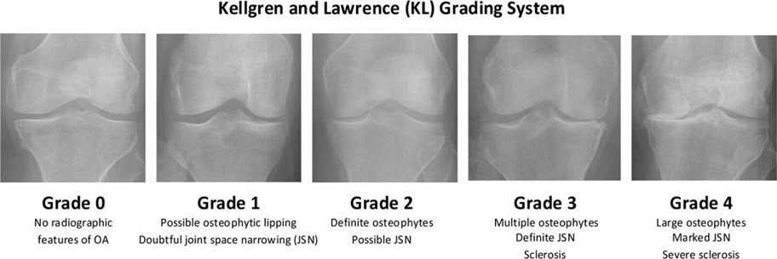

Slide 15
The number of classes in the dataset is: 5​
CLASS​
Healthy​
Doubtful​
Minimal​
Moderate​
Severe​
IMAGE COUNT​
2286​
1046​
1516​
757​
173​

Slide 16
Machine Learning
Machine learning (ML) : Machine learning is a field of study that focuses on developing algorithms and techniques that enable computers to learn from data and make predictions or decisions without being explicitly programmed.
We used Supervised machine learning (classification CNN)

Slide 17
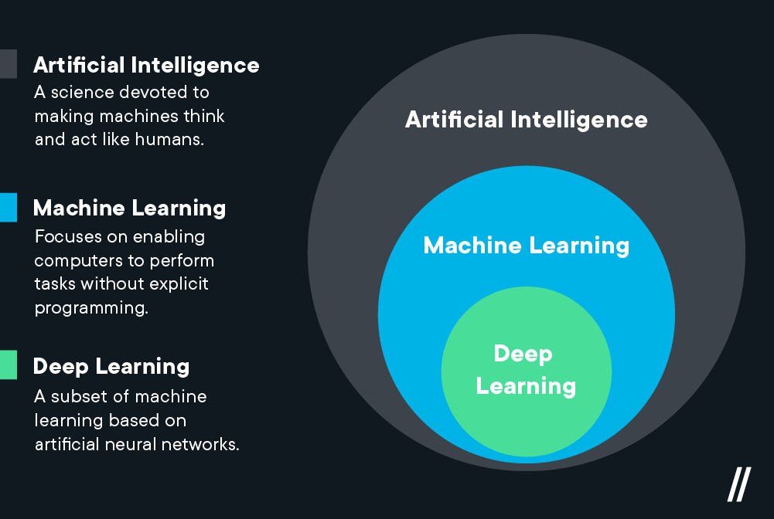

Slide 18
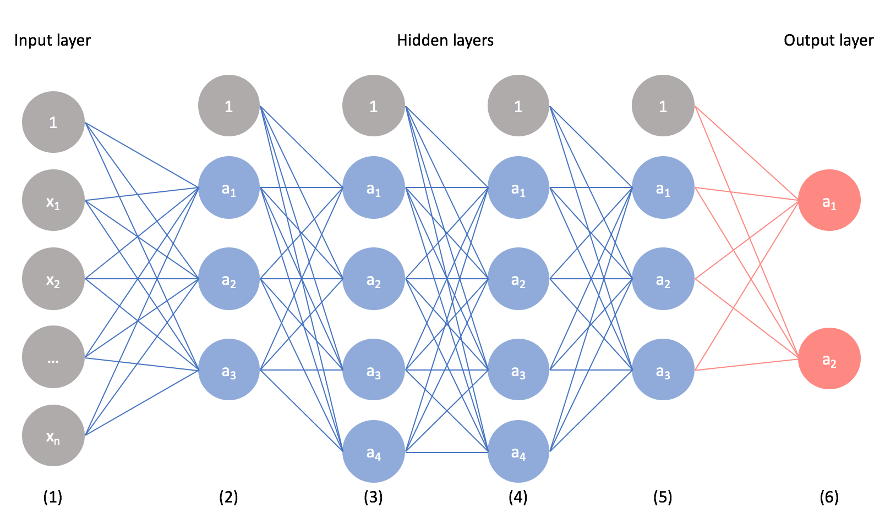
Neural network
Neural networks are powerful algorithms inspired by the structure of the human brain that are used to solve complex machine learning problems. You will build your own Neural Network from scratch to understand how it works. After this course, you will be able to create neural networks for solving classification and regression problems using the scikit-learn library.

Slide 19
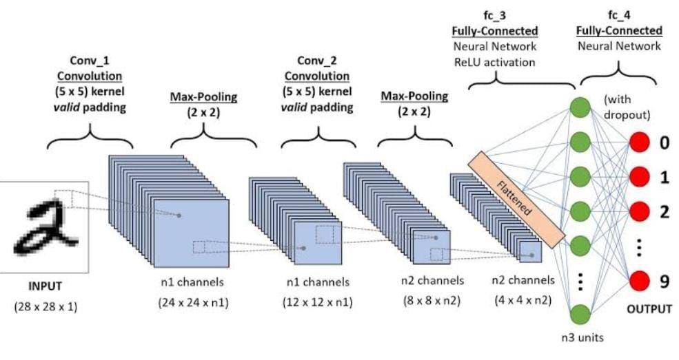
convolutional neural network (CNNs)
CNN stands for Convolutional Neural Network. It is a type of artificial neural network that is particularly well-suited for analyzing visual data such as images and videos. CNNs have revolutionized the field of computer vision and have become the go-to model for tasks such as image classification, object detection, and image segmentation.
CNNs have achieved remarkable success in various computer vision tasks and have been applied in many practical applications such as autonomous driving, facial recognition, medical imaging, and more.

Slide 20
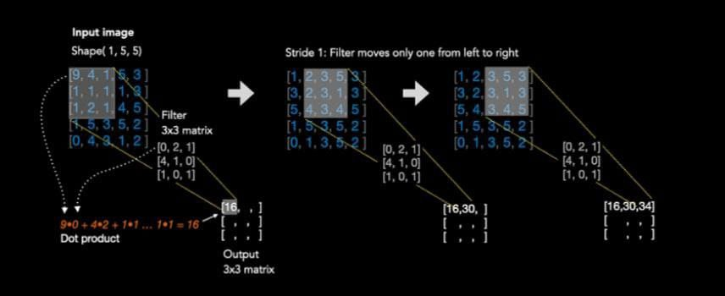

Slide 21
The models tested in the project
1-mobilNet
Disadvantages:Limited accuracy and relatively less efficiency EfficientNetB5
2-VGG-16
Disadvantages: Slow in training and implementation compared to efficientNetB5 due to the large number of layers and requires a large memory to store the parameters.
3-EfficientNetB5
In the end,we chose the model EfficientNetB5

Slide 22
The model used
EfficientNetB5 is a model within the EfficientNet family, which is a series of convolutional neural networks (CNNs)EfficientNetB5 is an advanced convolutional neural network that combines high accuracy with computational efficiency. Designed with compound scaling, it achieves an optimal balance of model width, depth, and resolution, making it suitable for a wide range of computer vision applications. Its high efficiency and accuracy make EfficientNetB5 an excellent choice for image classification tasks and use in resource-intensive environments.

Slide 23
Proposed Model
The proposed model will be discussed in the following subsections. provides the steps of the proposed model:
(1)input the x-ray image,
(2)pre-processing the image,
(3)training the data after we split it,
(4) then classification the degree of the KOA,
And give us the output whether its
Normal or minimal or doubtful or moderate or several

Slide 24
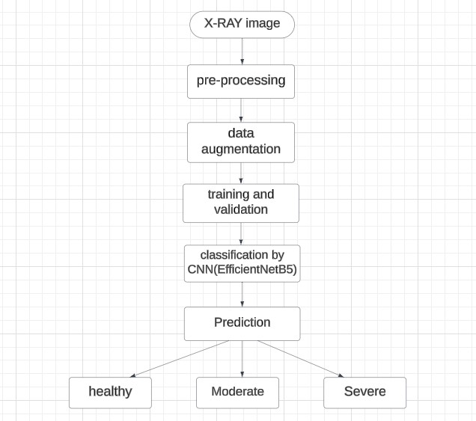

Slide 25
The Code Link
https://colab.research.google.com/drive/1FMBnNRJ6qfeeI97mA36dcTefvq8Q_ZpK#scrollTo=jumaldKGfgFV

Slide 26
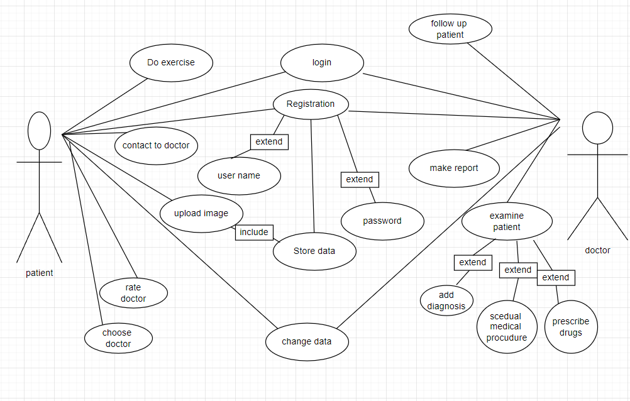
Use Case

Slide 27
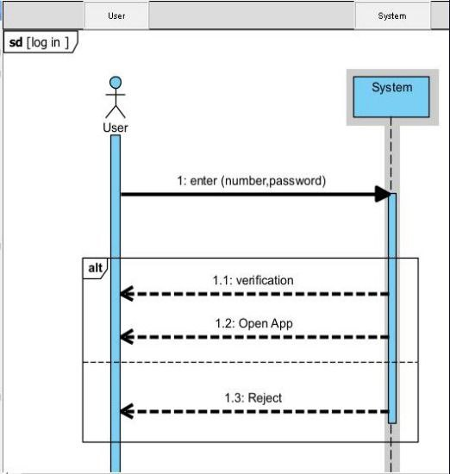

Slide 28
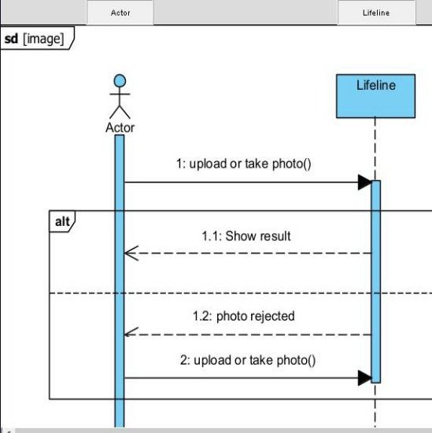

Slide 29
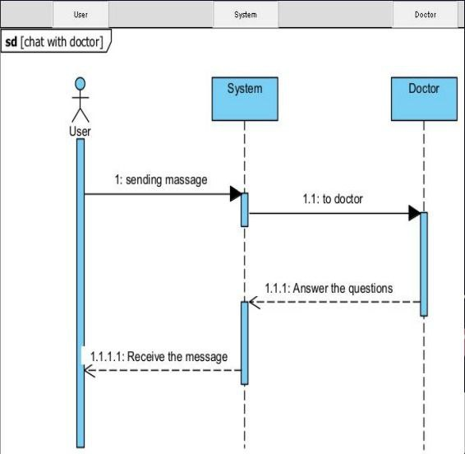
Sequence
diagram

Slide 30
Prototype (UI Design)

Slide 31
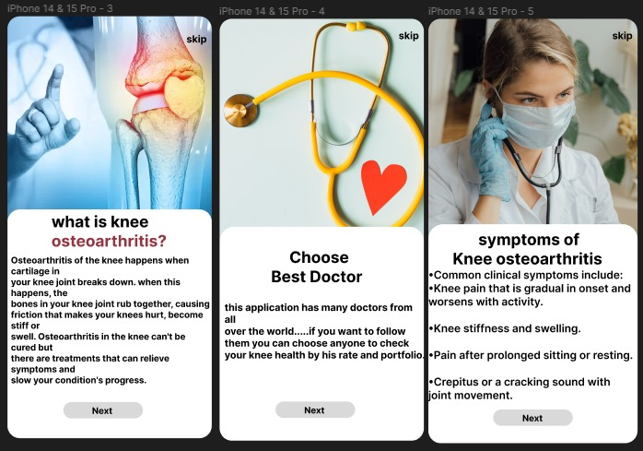
Figure of Description of application

Slide 32
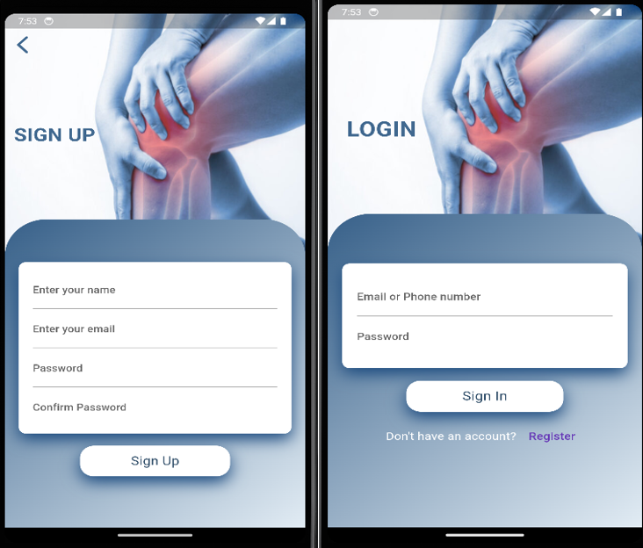
Figure of Sign up Page
Figure of Login Page

Slide 33
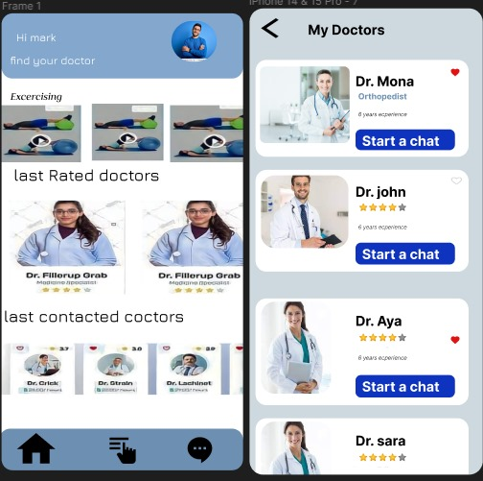
Figure of home Page
Figure of doctors Page

Slide 34
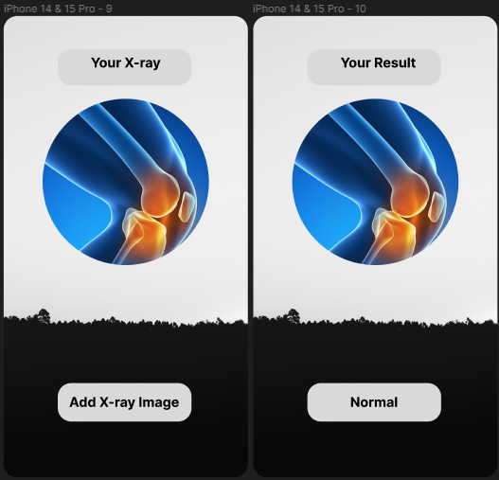
Figure of X-Ray Page
Figure of result Page

Slide 35
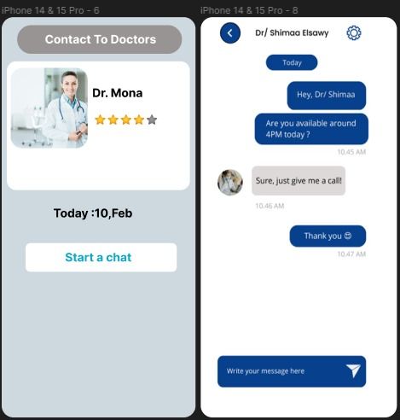
Figure of doctor profile Page
Figure of chat Page

Slide 36
Thanks
Do you have any questions?

